Slide 1


Practice all the data models with sample data
Design database to store Employee information.
      employee information.
      Department information.
      Attendance information .
      Note:- design with efficient schema

Slide 2
Indexes

Slide 3
Index Introduction
Indexes support the efficient execution of queries in MongoDB.
Without indexes, MongoDB must perform a collection scan, i.e. scan every document in a collection, to select those documents that match the query statement
MongoDB can use the index to limit the number of documents it must inspect.

Slide 4
Index Types
Default _id
Single Field
Compound Index
Multikey Index
Text Indexes

Slide 5
Default _id
All MongoDB collections have an index on the _id field that exists by default.
If applications do not specify a value for _id the driver or the mongod will create an _id field with an ObjectId value.
The _id index is unique and prevents clients from inserting two documents with the same value for the _id field.

Slide 6
Single Field
In addition to the MongoDB-defined _id index, MongoDB supports the creation of user-defined ascending/ descending indexes on a single field of a document
MongoDB indexes use a B-tree data structure.
Syntax:-
db.friends.ensureIndex( { "name" : 1 } )

Slide 7
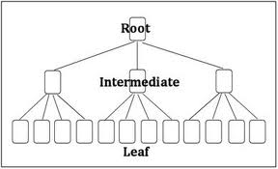
B-tree Structure

Slide 8
Compound Indexes
MongoDB supports compound indexes, where a single index structure holds multiple fields within a collection’s documents.
Syntax:-
db.products.ensureIndex( { "item": 1, "stock": 1 } )

Slide 9
Multikey Index
MongoDB uses multikey indexes the content stored in arrays.
MongoDB creates separate index entries for every element of the array.
These multikey indexes allow queries to select documents that contain arrays by matching on element or elements of the arrays.
Syntax:-
db.friends.ensureIndex( { “address" : 1 } ).
db.friends.ensureIndex( { “address.zip" : 1 } )

Slide 10
Text Indexes
MongoDB provides text indexes to support text search of string content in documents of a collection.
To create a text index, use the db.collection.createIndex() method.
To index a field that contains a string or an array of string elements, include the field and specify the string literal "text" in the index document, as in the following example:
db.reviews.createIndex( { comments: "text" } )

Slide 11
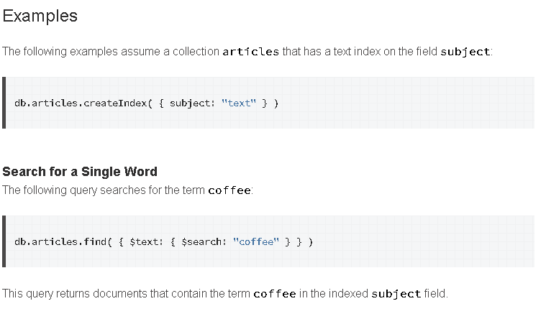
Text Indexes

Slide 12
Index Properties
TTL Indexes
TTL indexes are special single-field indexes that MongoDB can use to automatically remove documents from a collection after a certain amount of time.
Data expiration is useful for certain types of information like machine generated event data, logs, and session information that only need to persist in a database for a finite amount of time.

Slide 13
TTL Indexes
To create a TTL index, use the db.collection.createIndex() method with the expireAfterSeconds option on a field whose value is either a date or an array that contains date values.
For example, to create a TTL index on the lastModifiedDate field of the eventlog collection, use the following
db.eventlog.createIndex( { "lastModifiedDate": 1 }, { expireAfterSeconds: 3600 } )

Slide 14
Unique Indexes
A unique index causes MongoDB to reject all documents that contain a duplicate value for the indexed field.
To create a unique index, use the db.collection.createIndex() method with the unique option set to true.
For example, to create a unique index on the user_id field of the members collection, use the following
Eg:-
db.members.createIndex( { "user_id": 1 }, { unique: true } )
By default, unique is false on MongoDB indexes.

Slide 15
Sparse Indexes
Sparse indexes only contain entries for documents that have the indexed field, even if the index field contains a null value.
The index skips over any document that is missing the indexed field.
Syntax :-
db.addresses.createIndex( { "xmpp_id": 1 }, { sparse: true } )

Slide 16
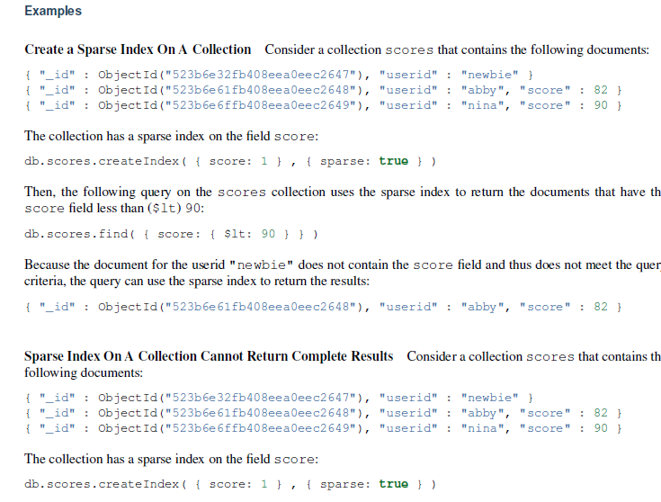
Sparse Indexes

Slide 17

How to find the index in collection
What is hint () in index
How to use hint ()
how to determine an index for an collection(senories to consider)

